Slide 1
Blood Relation

Slide 2
Definition and Concept
Questions in Test of Reasoning on Family/Blood Relationship are about the relationship of a particular person with another person of the family, based on the chain of relationships between other members of that family.
Family/Blood Relation Tests are an exercise to test the student’s ability to comprehend and come to the crux of an issue from complex, lengthy and even confusing data.

Slide 3
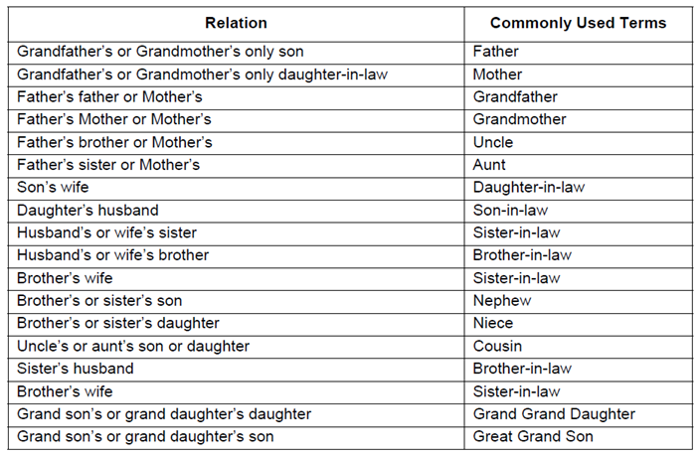

Slide 4
Great-Uncle/Aunt: A brother/sister to any of one's grandparents.
In-laws
In-laws only apply to brother, sister, and parents.
e.g. There is no relationship between you and your spouses cousins. My sister-in-law could be:
1. the sister of my spouse, or
2. the wife of my brother, or
3. the wife of my spouse's brother.

Slide 5
UNCLE: Uncle in American society this term can refer to a man in four different relative positions: father's brother; mother's brother; father's sister's husband; mother's sister's husband.
NEPHEW - NIECE: Nephew or Niece is one who is the child of a sibling (or a half-sibling, or step-sibling, or a child of a spouse's sibling, or your spouse's sibling. Since the term derives from the Latin term, "Nepos" meaning grandson, it is possible an early colonial reference may have this meaning.

Slide 6
Four thumb rule to solve Blood Relation Problems
Male is denoted by + sign and female by - sign in a family tree.
2. Father/mother and Son/daughter are joined by a vertical line to show generation gap between them.
Father/mother
Son/Daughter

Slide 7
3. Siblings(Brother sister) are joined by a horizontal line because there is no generation gap between them.
Brother Sister
Note: We never joined cousins by any line in a family tree as they are siblings from different parents.
4. Married couples are always written adjacent to each other but joined by a couple sign.
Husband Wife

Slide 8
Only use the details provided in the question to form the tree. DO NOT assume values on your own-Unless specifically provided or logically concluded.
Relations on the mother's side is called 'Maternal' while on Father's side is called 'Paternal'.

Slide 9
In every competitive exam and placement exam, Blood relation can be asked in the following three forms:
Type 1 : Indicating type or Deciphering jumbled up description
Type 2 : Relation puzzle ( A set of statements)
Type 3 : Coded blood relation ( In the form of Symbols)

Slide 10
Type 1: Indicating type Problems
1. Introducing Neeta, Anil(Male) said "She is the wife of my mother's only son'". How is Neeta related to Anil?
Wife
Sister
Mother
Aunt

Slide 11
If Kamal says ," Ravi's mother is the only daughter of my mother", how is Kamal related to Ravi ?
Grandfather
Father
Brother
None of these

Slide 12
Pointing towards photograph, Vipul said, "She is the daughter of my grandfather's only son." How is Vipul related to the girl in the photograph ?
Mother
Sister
Cousin
Grand Mother

Slide 13
Pointing towards a person in a photograph, Anjali said, "He is the only son of the father of my sister's brother." How is that person is related to Anjali ?
Father
Cousin
Brother
Maternal Uncle

Slide 14
Pointing out to a lady, Rajan said, “She is the daughter of the woman who is the mother of the husband of my mother”. Who is that lady to Rajan?
Aunt
Grand daughter
Daughter
Sister

Slide 15
If Neha says, "Amrita's father Raj is the only son of my father-in-law Mahesh,” then how Bindu, who is the sister of Amrita related to Mahesh?
Daughter
Wife
Niece
Grand daughter

Slide 16
The son of M is the father of N and grandfather of R. S is the daughter of N and sister of B. How is M related to B?
Grand father
Grand mother
Grand father's father
Data inadequate

Slide 17
Type 2: Relation Puzzle
In these types of problems, relations will be given in the form of puzzle i.e. a set of statements. We need to draw the family tree according to given statements and answer the questions based on those relations.

Slide 18
'Ram' is the father of 'Kusha' but 'Kusha' is not his son. 'Mala' is the daughter of 'Kusha'. 'Shalaka' is the spouse of 'Ram'. 'Gopal' is the brother of 'Kusha'. 'Hari' is the son of 'Gopal'. 'Meena' is the spouse of 'Gopal'. 'Ganpat' is the father of 'Meena'. Who is the grand daughter of 'Ram'?
A. Mala
B. Meena
C. Hari
D. Shalaka

Slide 19
X is the husband of Y. W is the daughter of X. Z is the husband of W. N is the daughter of Z. What is the relationship of N to Y.
A. Cousin
B. Niece
C. Daughter
D. Grand daughter

Slide 20
Directions (3-5):In a family there are eight members. A is mother of B, who is brother of C. C and Q are siblings. Y is daughter of P. Z is brother in law of B, who is son of D. A has only one son. There are only two married couples in the family. P is married to B.
3. How is P related with Z?
A. Brother
B. Daughter
C. Nephew
D. None of these

Slide 21
How is C related with Y?
A. Aunt
B. Daughter in Law
C. Uncle
D. Grand father

Slide 22
How many male members are there in the family?
A. Four
B. Three
C. five
D. Two

Slide 23
Type 3: Coded Blood Relation
In these types of problems, relations will be given in the form of codes and symbols. We need to draw the family tree according to given symbols and answer the questions based on those relations.

Slide 24
‘ P +Q’ means that P is the son of Q, ‘P-Q’ means that P is the wife of Q, ‘P*Q’ means that P is the brother of Q, ‘P/Q’ means that P is the mother of Q and ‘P=Q’ means that P is the sister of Q. then, what does X+Y-Z mean?
Z is the father of X
Z is the son of X
Z is the uncle of X
Z is the brother of X

Slide 25
If ‘A × D’ mean ‘D is the sister of A’, ‘A + D’ means ‘D is the daughter of A’ , ‘A ÷ D’ means ‘A is the wife of D’, and ‘A-D’ means ‘A is brother of D’ then which of the following expression shows ‘J is sister of K’ ?
J - K ÷ P + L
K + P + M × J
J – K ÷ L + P
K – J ÷ L + P

Slide 26
Direction for Q3 & Q4: Study the following information carefully to answer these questions.
‘A$B’ means ‘A is mother of B’
‘A#B’ means ‘A is the father of B’
‘A@B’ means ‘A is the husband of B’
‘A%B’ means ‘A is daughter of B’
P@Q$M#T indicates what relationship of P with T?
Maternal Grandfather
Maternal Grandmother
Paternal Grandfather
None of the above

Slide 27
Which of the following expressions indicates ‘R is the sister of H’?
R$D@F#H
H%D@F$R
R%D@F$H
H$D@F#R

Slide 28
Directions (5-6):
‘A × B’ means ‘A is mother of B’.
‘A – B’ means ‘A is brother of B’.
‘A + B’ means ‘A is sister of B’.
‘A ÷ B’ means ‘A is father of B’.
5. If the expression M × N + R ÷ T is true, then which of the following is true?
A. M is father of R
B. N is aunt of T
C. M is grandfather of T
D. T is sister of N

Slide 29
6. Which of the following means ‘Q’ is brother of ‘T’?
A. Y ÷ Q – T + R
B. T ÷ Q – Y- R
C. T × M – R + Q
D. T + M ÷ Y + Q

Slide 30


